Slide 1

Get to Know DATA SCIENCE
Mohamad Irwan Afandi

Slide 2

Table of Content
1. What is data science
2. Why we need data science
3. Data science in daily life
4. The Essential skill needed by data scientist
5. Data science tools
6. Data science framework
7. Role in data world

Slide 3

What is Data Science
Data is a collection of facts, something that can be observations or just descriptions of things.
Science is knowledge to discover new things
Data Science is a process discover hidden patterns from the raw of data using science methodology (statistic, algorithm and machine learning principles).
https://www.edureka.co/blog/what-is-data-science/
https://www.mathsisfun.com/data/data.html

Slide 4



WHY WE NEED DATA SCIENCE
Social Media
Maps
Email
Bank
Transaction
NOT
E-commerce
BIG DATA
41.000 EXAbyte
PROCESSED
2020
DATA
2005
130 EXAbyte
data that is not processed is called garbage

Slide 5




DATA SCIENCE In Daily Life
Customer
Segmentation
Future
Prediction
Fraud
Detection
Market
Analysis
Safe driving car, customer churn, smart city, Etc.

Slide 6




PROGRAMMING
STATISTICS
BUSINESS
DATA SCIENCE Essential Skills

Slide 7








PREREQUISITES FOR DATA SCIENTIST
SOFTSKILL
HARDSKILL
Curiosity
High motivation to learn and never give up
Machine Learning
Programming
Database
Common sense
Know what we have to do with the problems
Communication Skill
How we present the results we get
Math
Modeling
Statistics

Slide 8
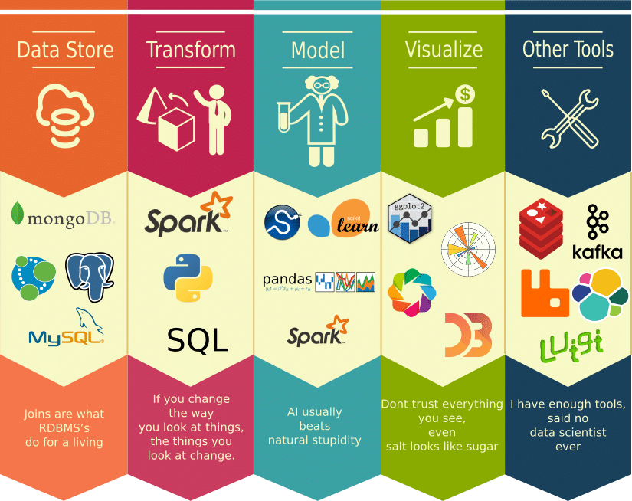

DATA SCIENTIST
TOOLS

Slide 9
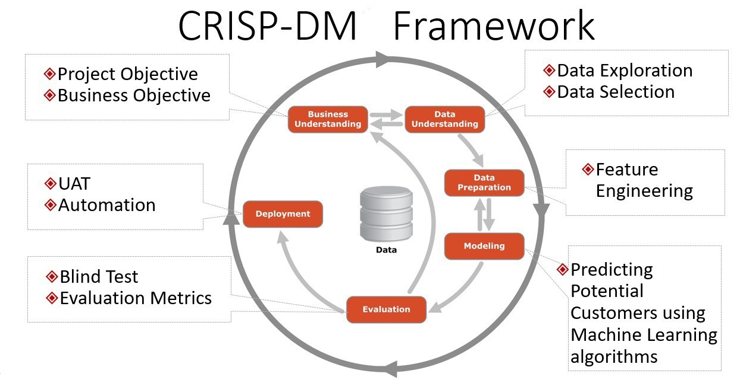
DATA SCIENCE Framework CRISP-DM
Cross Industry Standard Process for data mining
https://medium.com/@sumit.yg/analyzing-seattle-s-airbnb-listings-data-49abdc0977c8

Slide 10



CRISP-DM
BORROWER SCORING
on Agriculture Sector
01
02
03
Determine borrowers who deserve to be funded is very difficult
Collect the data from previous data (RDBM), Weblog (NoSQL), or Third party like AFPI (JSon)
Identify data problems
Discover new insight
Dealing with missing value, outlier, redundant data, different format, imbalance data, standardization, etc
Create recommended system to help credit scoring department
04
05
06
Determine the methodology (machine learning or logic programming)
Determine important factor
Build the model
Evaluate the model using some matrix accuracy to see the model performance.
Determine whether go to the next step or return to previous
Deploy the model in our software (website or mobile apps)
https://www.sv-europe.com/crisp-dm-methodology/

Slide 11

[3]
Machine Learning
Engineer
[2]
[4]
Data
Engineer
Focus on implementing the model made by DS
Data
Scientist
Prepare the infrastructure for DS like database, server, create
data processing pipeline, etc
Define problem, understanding the data, data exploration, modeling and evaluate
[1]
[5]
Data
Analyst
Business
Intelligence
Focus on Analyzing the data,
get the insight, and implement on business.
Define business problem/goal,
transfer data into business insight, and deliver to user
Data Science Role
https://blog.udacity.com/2018/01/4-types-data-science-jobs.html

Slide 12

Thank you …

